Slide 1
Gain the Tools to Design Repeatable, Scalable Workflows for Your Accounting Firm

Slide 2
Attending this Breakout Session for the full 100 minutes entitles you to 2 hours of CPE
Please have your badge scanned by a room monitor before the session begins.
Scanning your badge ensures you get credit for attending the session.

Slide 3
About Today’s Speaker
Accounting Lifeline, CEO
Co-Host of The ‘Appy Hour
Insightful Accountant’s QBO Contributing Editor
Intuit Advanced Certified QuickBooks Online ProAdvisor
Member of the Intuit Trainer/Writer Network
International Speaker and Trainer
Liz Scott
Accounting Technology Wiz

Slide 4
Agenda
Diagnose & Discover Pain Points
Explore Solutions - Break Out Sessions
How to Create Plan for your Future Firm

Slide 5
Industry Pain Points

Slide 6
Notes:
One SAD tree (Charlie brown) – birds try to sit on tree but tree is not strong enough

Slide 7
Elements
Notes:
Elements tree needs to grow – Soil (soil can also be toxic or nutritious), sun, night

Slide 8
Strong tree
Notes:
STRONG tree - Everything (birds - customers, leaves – money, limbs services offerings, roots - people workflow and apps

Slide 9
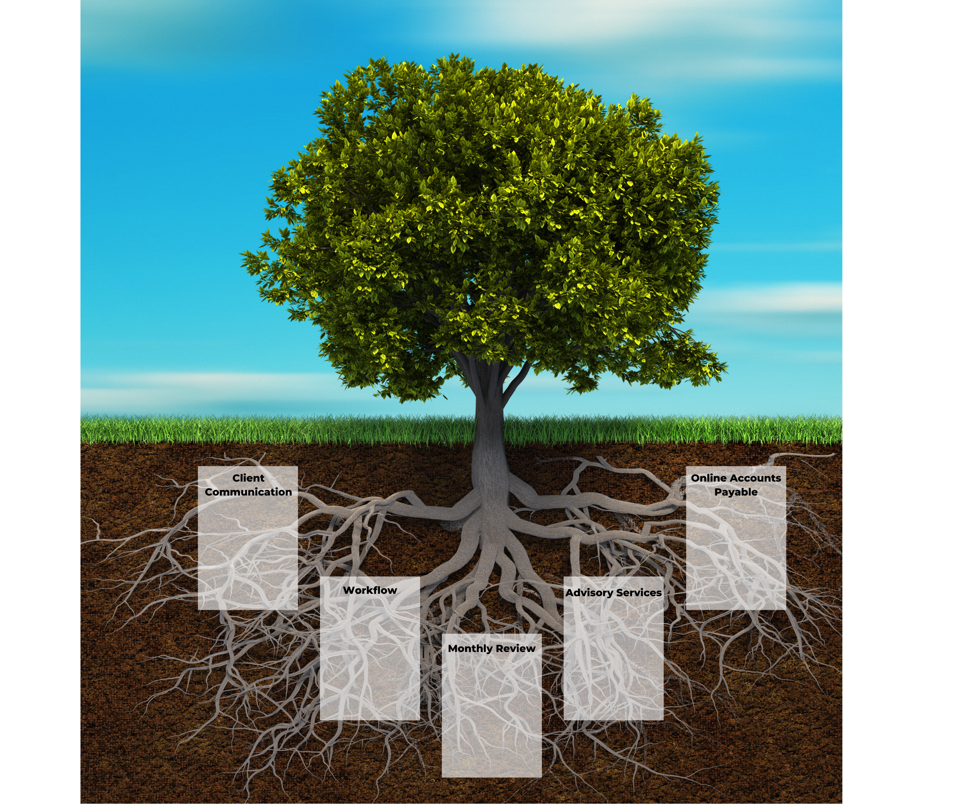
Strong roots
Notes:
Strong Roots – Foundation of the tree – the people, workflow which can include solutions that are part of the workflow

Slide 10
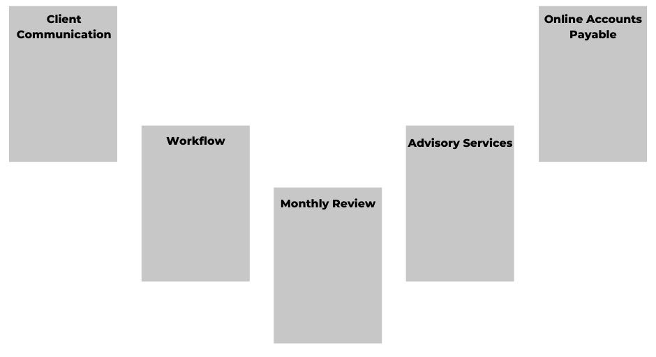
Solutions

Slide 11
Accounts Payable
Month-End Review
Client Communication
Client Workflow
Forecast Advisory

Slide 12
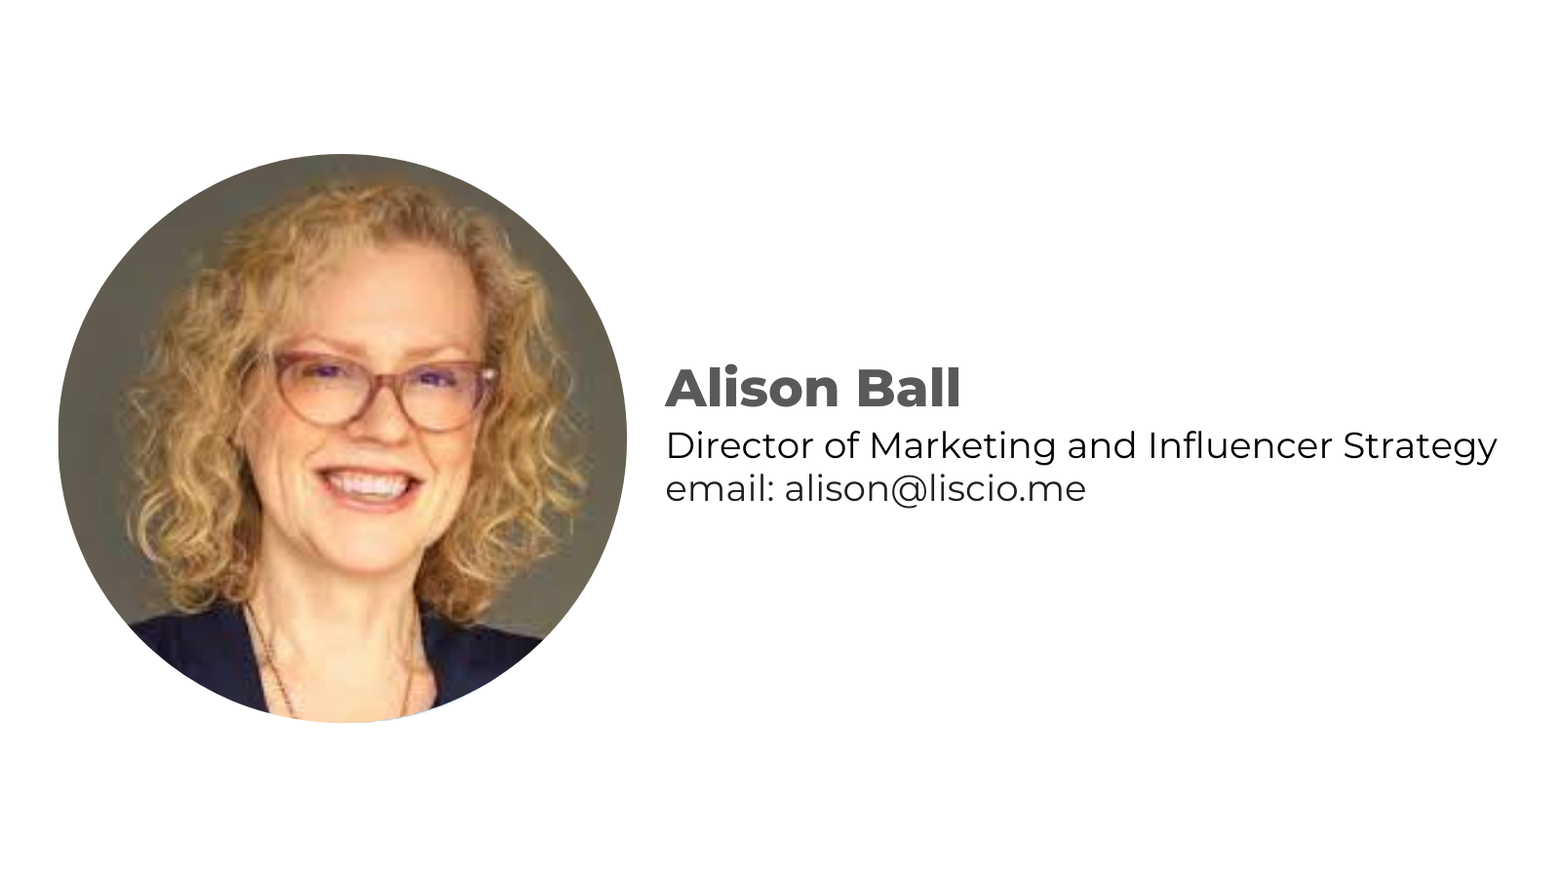
CLIENT COMMUNICATION
Notes:
Client Communication

Slide 13
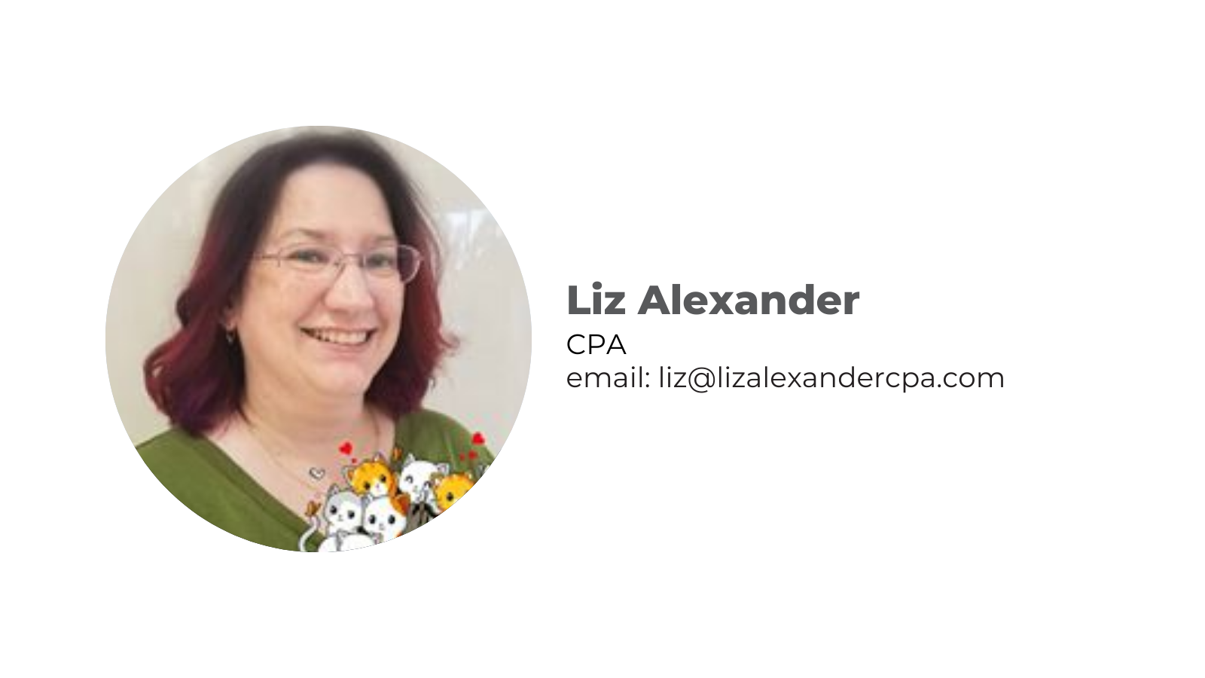
MONTH-END REVIEW
Notes:
Client Workflow

Slide 14
FINANCIAL ADVISORY
Notes:
Financial Advisory

Slide 15
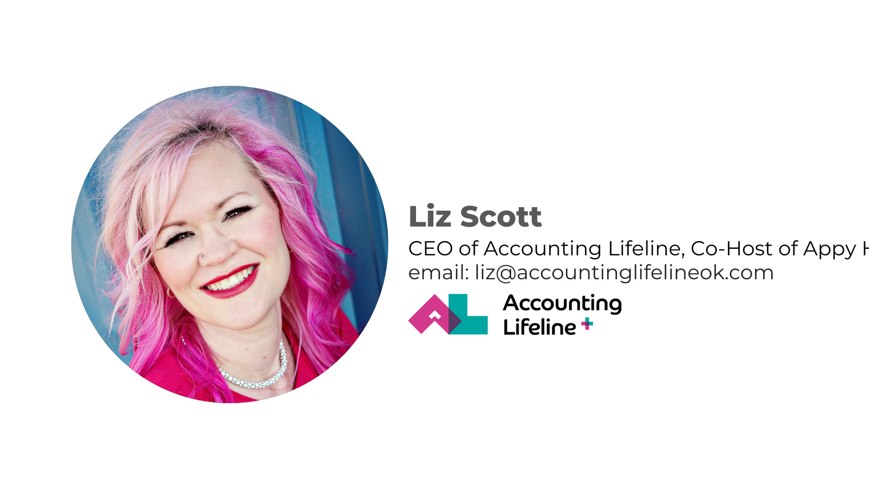
CLIENT WORKFLOW
Notes:
Client Workflow

Slide 16
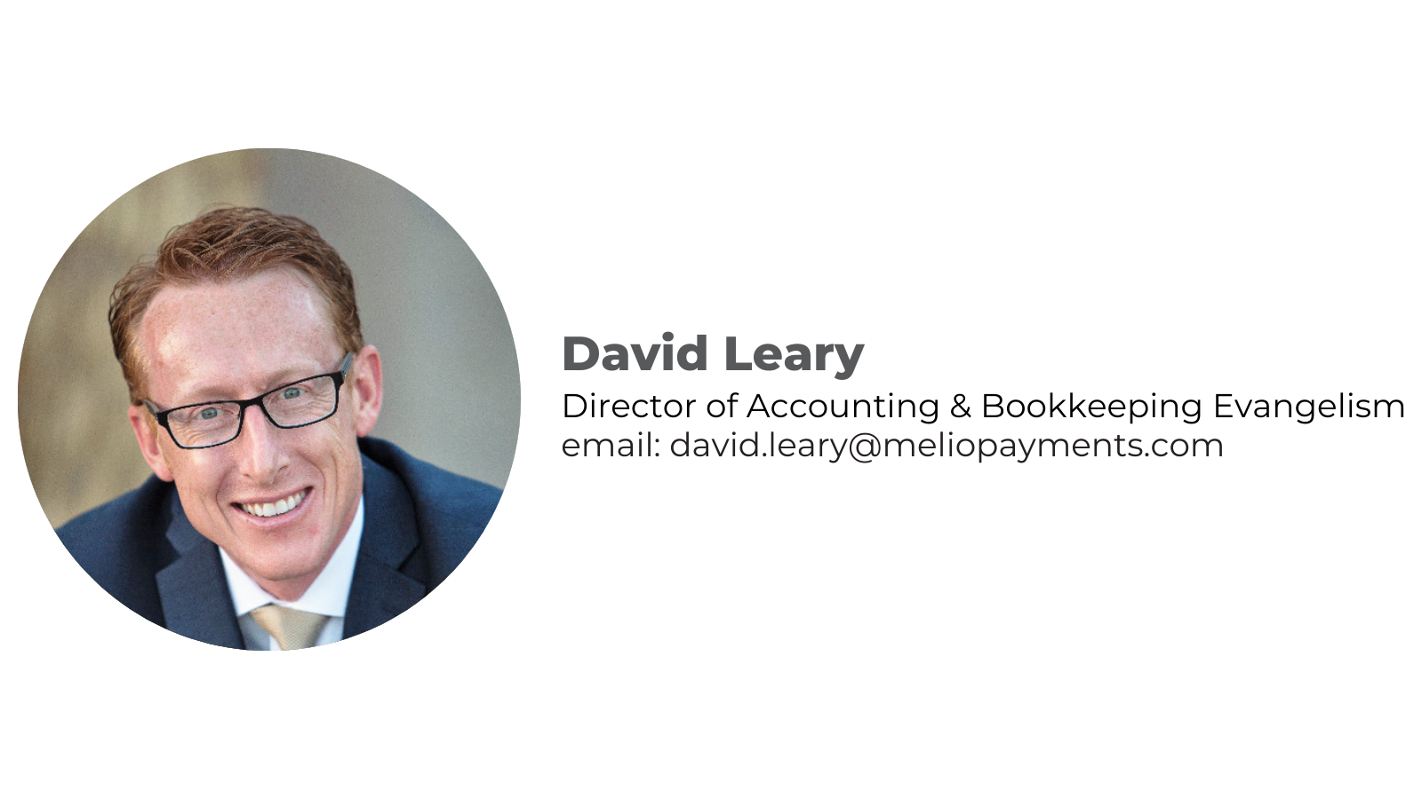
ACCOUNTS PAYABLE

Slide 17
Grow
your
tree
Notes:
Grow your tree – Foundation of the tree – the people, workflow which can include solutions that are part of the workflow

Slide 18
Q&A

Slide 19
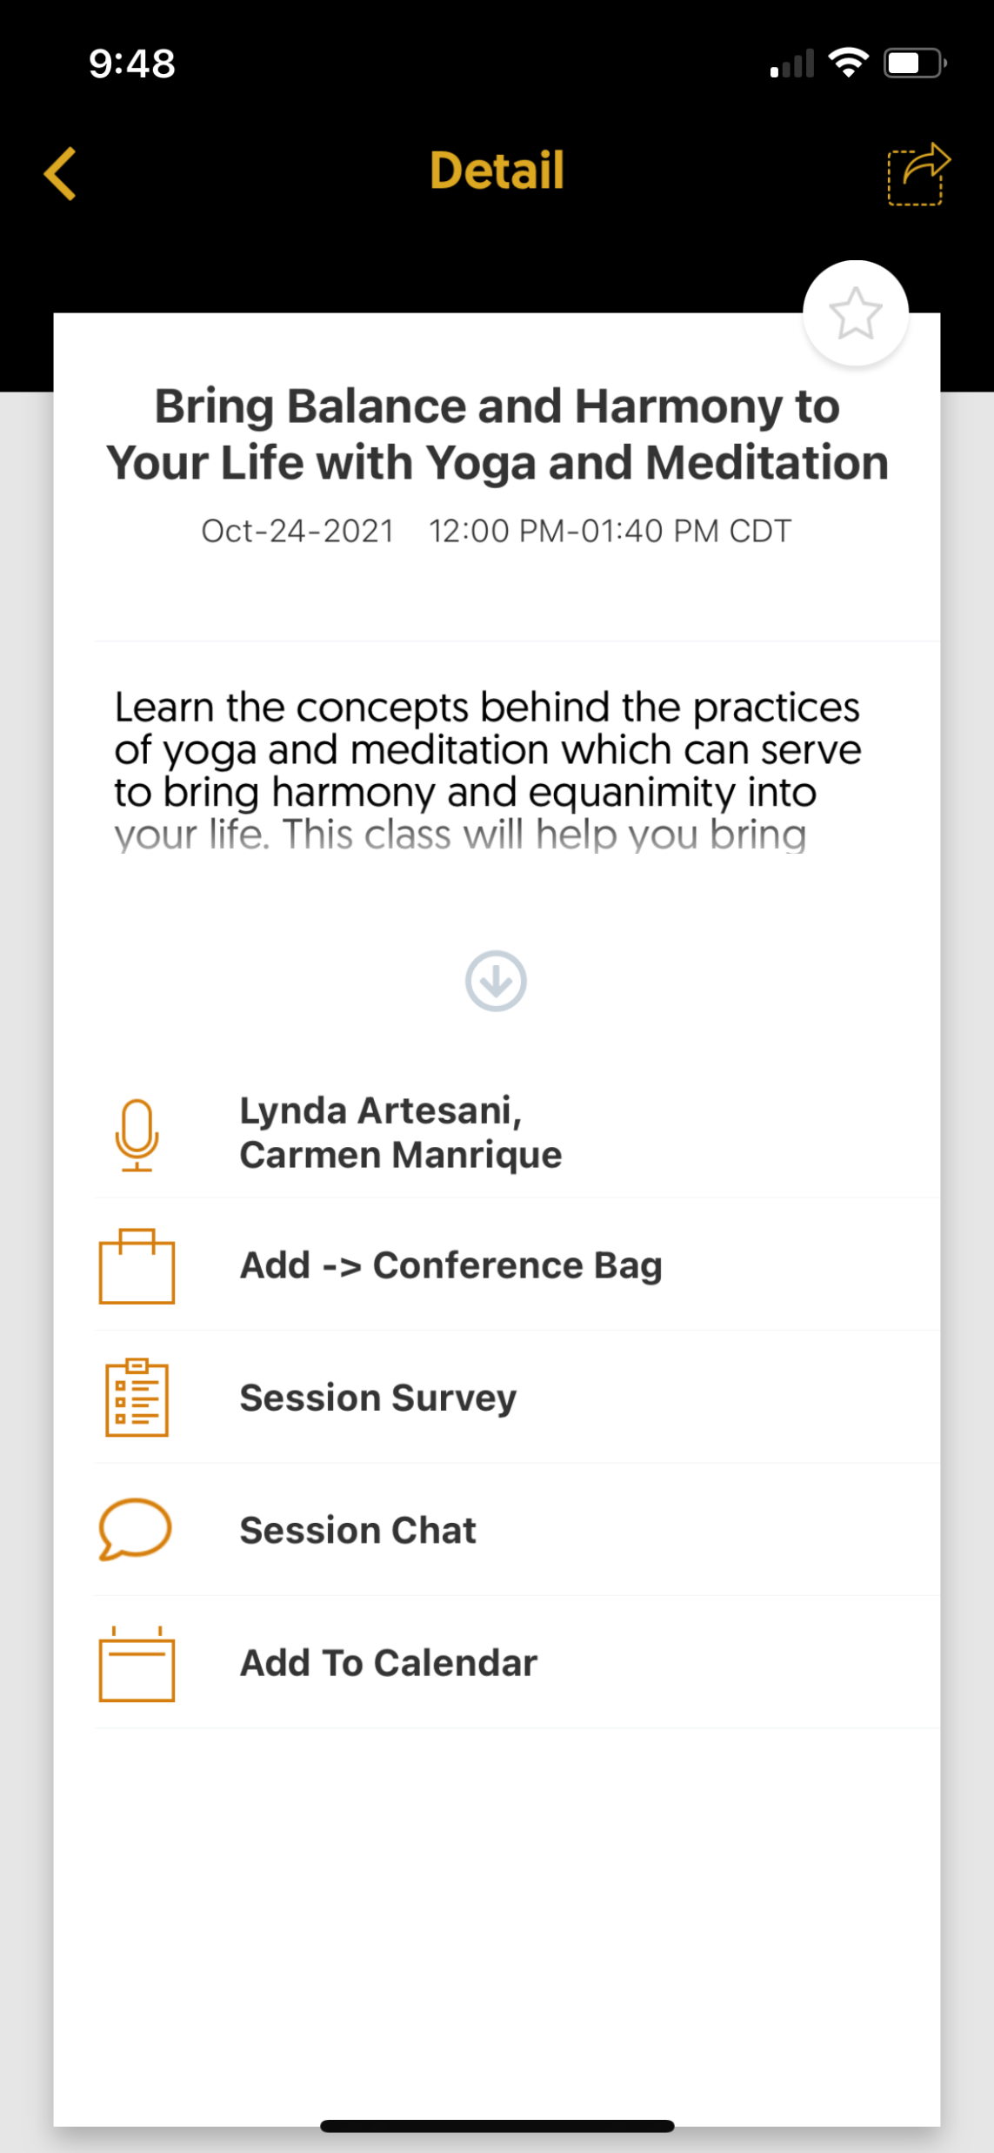
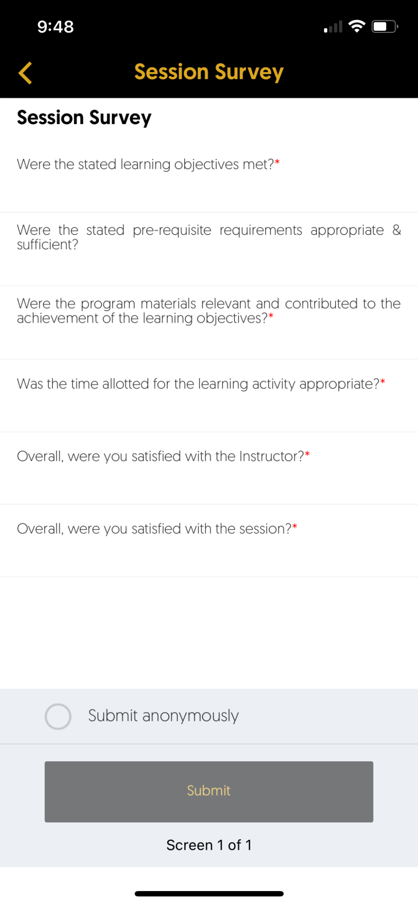
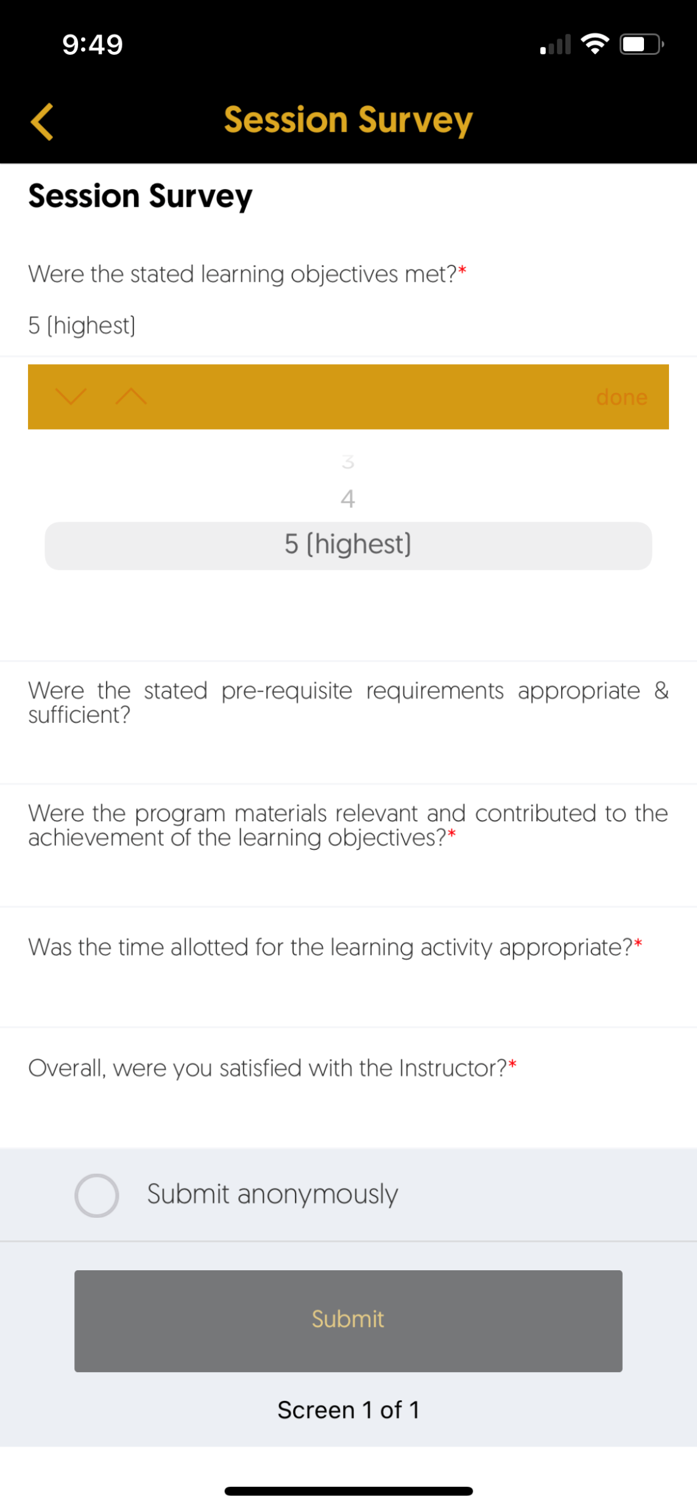
We Value Your Feedback!
Please complete the Session Survey in the Conference App for this session!

Slide 20
Do You Have Additional Feedback?
We would love to hear from you!
Email us at info@woodard.com

Slide 21
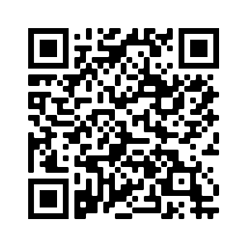
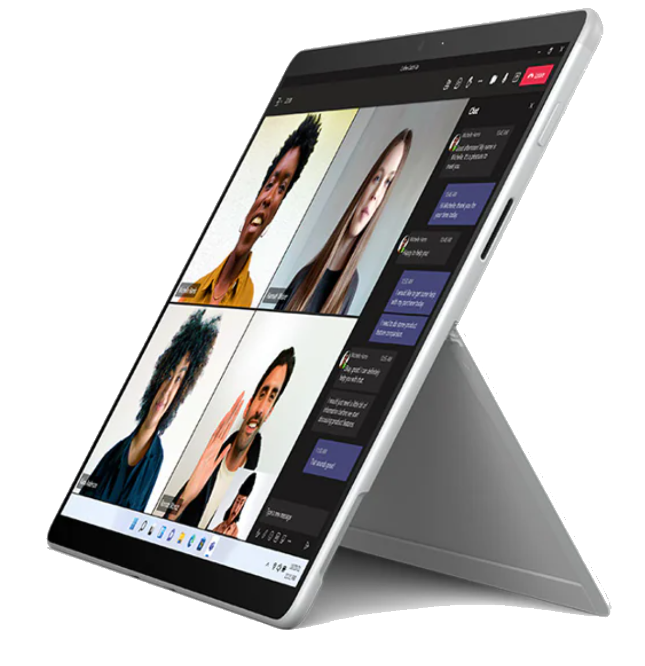
Here is Your Chance to Win!
Want a chance to win a cellular-capable Windows 11 Microsoft Surface Pro X?
You can! It’s as easy as 1, 2, 3.
Point your camera app at the QR code and open the contest page
Answer the 10-question quiz before Tuesday at Noon Central to enter
Go to the Woodard booth for the drawing on Tuesday @ 3:30 pm*
Brought to you by:
$1,300 Value!**
*Contest limited to conference registrants. One entry per person. Additional rules and limitations apply and can be viewed on the contest page.
** Including Windows 11 Microsoft Surface Pro X and computer setup support.

Slide 22
Next Up: More Cutting-Training Please make your way to your next session

Slide 23
Gain the Tools to Design Repeatable, Scalable Workflows for Your Accounting Firm

